Slide 1
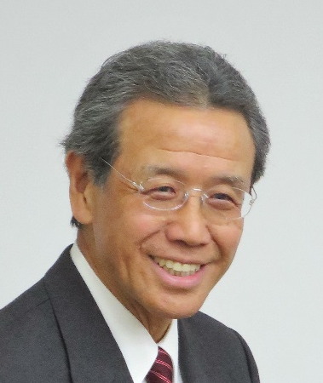
1st Friendship International Research Symposium
Applications of Ancient Medicine, Energy Medicine,
Integrative Medicine in the Present World
20th Anniversary Memorial Event for the relationship between Prof. IORIO & Wismerll
Prof. OLIVEIRA
Prof. IORIO
DATE: 22nd June 2023, 14:30～17:30
VENUE: Ochanomizu Education Center
(5th Floor Tonegawa 2 building
1-6-1 Yushima, Bunkyo-ku, Tokyo)
ORGANUZER: International Observatory of
Oxidative Stress (Italy)
& Wismerll Institute
Prof. FILHO
Prof. SCAPSGNINI
Prof. SHIMOTSUURA
Prof. YAMAKADO
Mr. SEKI

